Slide 1
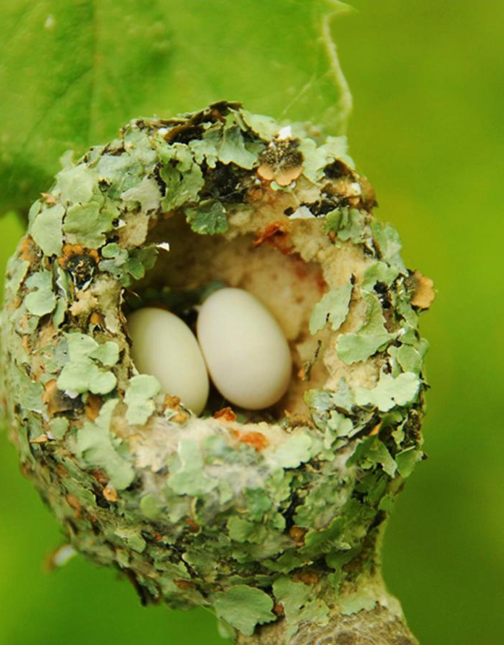
CLAIMS GUIDELINES
Prepared and presented by:
Thomas Victor Oduor
Supervision Officer
Insurance Regulatory Authority
© 2013 IRA. All rights reserved. Contains IRA‘s Confidential and Proprietary information and may not be disclosed or reproduced without the prior written consent of IRA.

Slide 2
Nature of Complaints lodged with IRA
All types of insurance complaints are lodged with IRA
Use of vehicles
Delays in claims settlement
Delay in repairs
The complaints are both long term and short term
Declinature of claims
Unsatisfactory settlement of claims
Non-disclosure of facts by providers/intermediaries
Complaints by intermediaries

Slide 3
Nature of Complaints lodged with IRA
Payment of commissions
Claw-back
Lost policies
Third party Motor claims
Lawyers not remitting benefits
Lawyers abandoning cases mid-stream
Complaints against collapsed companies

Slide 4
CLAIMS GUIDELINES

Slide 5
Why the Guidelines
The insurance industry faced with challenges in claims management
Poor image of the industry
Low penetration of insurance services
Most complaints relate to claims management
Need for action by the regulator

Slide 6
Objective
The Authority has developed this set of claims management guidelines in order to enhance
Efficiency ;
Transparency;
Disclosure of information to policyholders;
Increase consumer satisfaction;
Enhance compliance with the provisions of section 203 of the insurance act.

Slide 7
Pre-loss information
While issuing the policy, insurer shall inform policyholders on what to do;
Need for policyholders to cooperate
Allow the insurer to handle inspection and assessment prior to settlement.
Explain what subrogation, contribution, excess, average clauses are.
Loss minimization.
Report the claim in a timely manner
to preserving evidence

Slide 8
Notification & acknowledgement
Use any fast means of communicating;
(a) Direct reporting
(b) Telephone call
(c) Text message
(d) E-mail
(e) Fax
(f) Letter
(g) Use of social sites or websites
(h) Any other form of technology of wide usage.

Slide 9
Upon Receipt of the Notification
The insurer shall take the following action not later than seven working days;
Acknowledge the notification.
Avail appropriate claim form;
Avail a list of specific documents required;
Provide any necessary additional information;
Contact any other insurer involved
Appoint a service provider(s) where necessary.

Slide 10
Upon receipt of a claim
Pay within 90 days where a claim is admissible;
Appoint a service provider where further assessment is necessary;
Upon receipt of the assessment report make an offer for settlement;
Notify the claimant where further investigation is necessary;
Explain to the claimant the need to co-operate with the investigators.

Slide 11
Upon receipt of a claim
Where is not covered by the policy, explain to the claimant;
If the amount offered is different from the amount claimed, explain to the claimant;
Notify the claimant where insurer is not responsible for the claim;

Slide 12
Claims Handling procedures
Develop a manual on claims handling procedures including;
Steps from claim intimation to settlement
Timeframes in each of the steps
Include in the manual
clearly defined control and
reporting systems and processes.
File the manual with the Authority
Notify the Authority of any changes to the manual.

Slide 13
Claims Handling procedures
Inform the claimants about;
Procedures, Formalities and Common time frames for claims settlement.
Inform the claimant about the status of the claim.
Explain claims conditions such as depreciation, average, pre-loss value, reinstatement, excess/deductibles etc.
Issue a copy of the report to the claimant on request.
Refund excess of subrogation to the insured

Slide 14
Issues specific to Motor Claims
Need for valuation of motor vehicles at inception and renewal of cover;
Need to determine pre-accident values after a loss;

Slide 15
Issues specific to Motor Claims
Contribution for Motor Vehicle repairs;
insured only contributes towards repairs where;
Components in the vehicle are subject to continuous wear and tear with such components include but are not limited to;
(i) Tires and tubes
(iii) Batteries
(iv) Engine overhaul parts
(v) Gear box, transmission and transfer cases.

Slide 16
Issues particular to motor claims
(b) Where the vehicle requires rebranding after repairs.
(c) The repair requires a set of similar items to be replaced whilst only one of the items was damaged in the accident.

Slide 17
Write-off
A motor vehicle will be considered a write-off if the repair estimate value as per the assessment report exceeds economical level.
The insurer shall accord the claimant the opportunity to contest the basis of valuation leading to the write-off.

Slide 18
Disposal of salvages
Where the vehicle is a write-off but repairable, accord insured opportunity to retain the salvage;
If he forfeits he shall be indemnified on the basis of the pre-accident value;
No insurer shall dispose of salvage before the insured is indemnified;
Where the insured chooses to retain the salvage, the insurer may deduct salvage value from the settlement amount;

Slide 19
Duty Free Vehicles
Market value basis
Where a duty free vehicle is insured at market value there will be no contribution for repairs provided in case of write off or theft, the insured shall be required to clear with the Kenya Revenue Authority before compensation.
In case of a write off, the insured will be indemnified on duty free basis and will retain the salvage.

Slide 20
Duty Free Vehicles
Duty free basis
Where a vehicle is insured on duty free basis, liability of the insurer for repairs will be limited to the proportion that the duty free value of the vehicle bears to its market value.
In case of a write off or stolen, the insured will be indemnified on duty free basis and will retain the salvage.

Slide 21
Customer Care Desk
Establish a customer service desk where queries and complaints will be lodged and resolved.
The desk will be used to lodge, route enquiries and complaints.
The desk shall be equipped with skilled and competent officers.
Have in place a documented system and procedure for receiving, registering and disposing of complaints.

Slide 22
Customer Care Desk
Keep updating the claimant on the claim progress.
Provide the final response in writing within a reasonable time.
If complainant is dissatisfied with the final response, provide advice on availability of external complaints settlement procedures including Authority.

Slide 23
Disposing off claims
A complaint will be considered as disposed off when;
The company has fully acceded to the request of the complainant.
All parties to the complaint have been satisfied and the matter marked as closed.

Slide 24
Submission of Claims Returns
Every Insurer shall file with the Authority monthly and annual returns in a;
Prescribed format as provided under
Section 203 as read together with
Principal Regulation 48 of the Insurance Act.

Slide 25
END
Thomas Victor Oduor
Consumer Education Officer
Insurance Regulatory Authority (IRA)
P.O BOX 43505 - 00100 NAIROBI
Zep-Re Place Off Mara Road - Upper Hill, Nairobi
Tel: (+254) 20 4996000, 0727 563110
Mobile: (+245) 0 719047000
Fax: (254)- 020- 2710126
Email: corporate@ira.go.ke
www.ira.go.ke

Slide 26
Q & A

